Slide 1


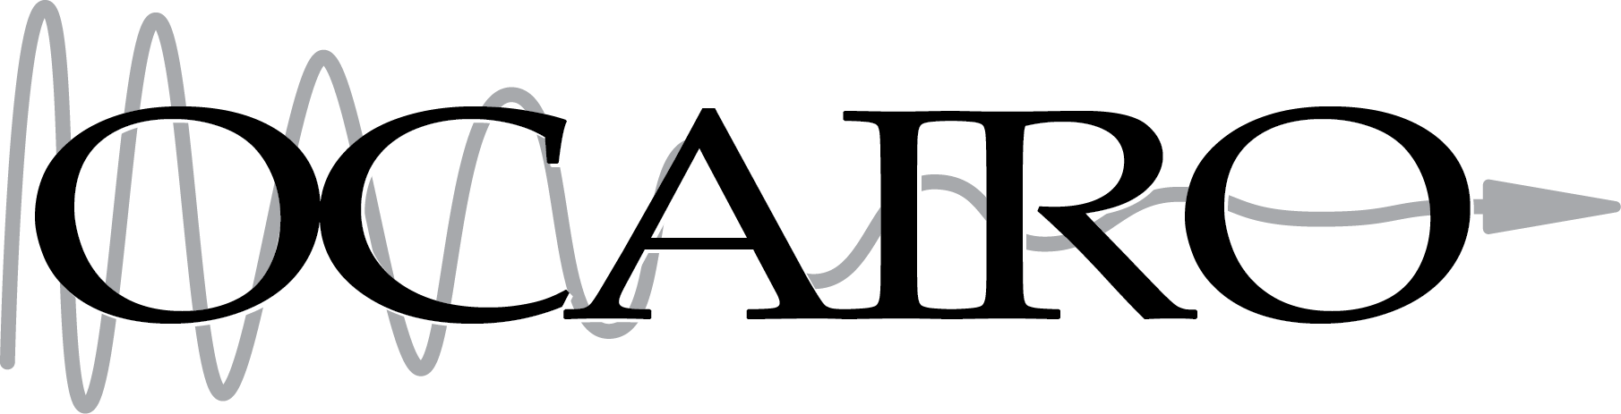

Tutorial: Film Dosimetry Analysis Slicelet
IC3DDose 2016
November 10, 2016

Slide 2



Material
Connect to tutorial wifi: SSID: Slicer Workshop, Password: gelitup!
Access download page: Enter in your web browser: 192.168.1.5
Follow the instructions
Supported platforms: Windows, Mac OSX, Linux
32-bit is not supported!

Slide 3
Install 3D Slicer
Find the downloaded 3D Slicer package on your computer
Follow the usual steps to install an application
Different for each operating system

Slide 4
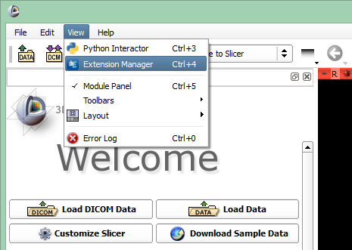

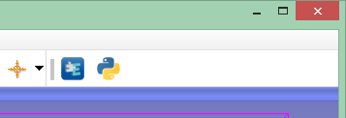
Install SlicerRT extension
or

Slide 5
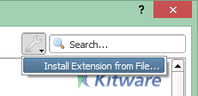
Install SlicerRT extension
Find the downloaded SlicerRT zip file on your computer

Slide 6
Install Film Dosimetry Analysis extension
Find the downloaded Film Dosimetry Analysis zip file on your computer

Slide 7
Install Gel Dosimetry Analysis extension
(for later)
Find the downloaded Gel Dosimetry Analysis zip file on your computer
Click Restart

Slide 8
Unpack tutorial datasets
Find the dataset you downloaded named Gel_Dosimetry_Dataset.zip Film_Dosimetry_Dataset.zip
Unpack it to a local folder of your choice
Different for each operating system

Slide 9
Learning objective
This tutorial will teach you how to perform film dosimetry analysis, irradiated with a clinically relevant dose distribution.

Slide 10
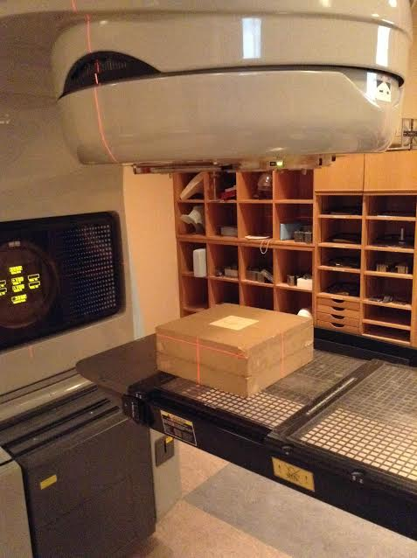
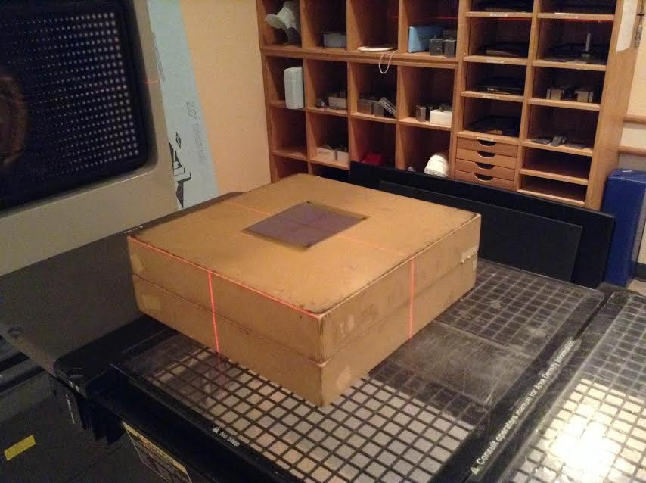
Where did this data come from?
Calibration films were irradiated in well characterized radiation fields (10x10 cm² at d_{max}) to a range of doses

Slide 11
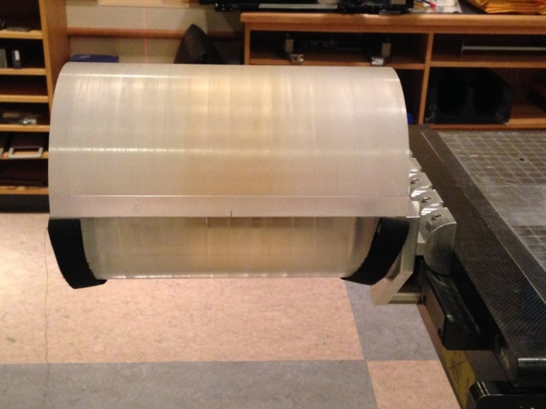
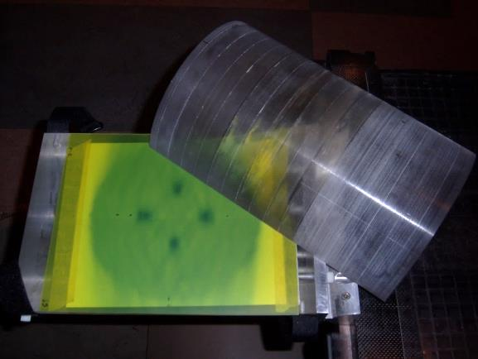
Where did this data come from?
Treatment planning using Eclipse:
Dual arc delivery FSRT VMAT (4 Gy delivered to mets, plus 2 Gy SIB)
Delivery to a cylindrical phantom with film at isocenter plane
Outputs: Planning dose volume, Structures

Slide 12
Where did this data come from?
Irradiation day:
Quarter sheets of Gafchromic EBT3 film used for calibration points
Full sheet irradiation for experimental/measured film (FSRT VMAT irradiation)

Slide 13
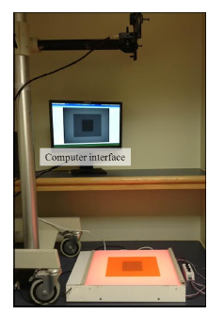
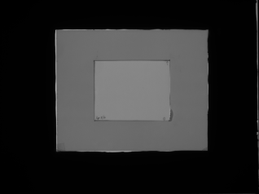
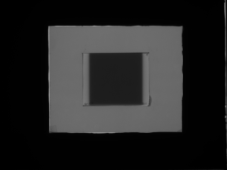
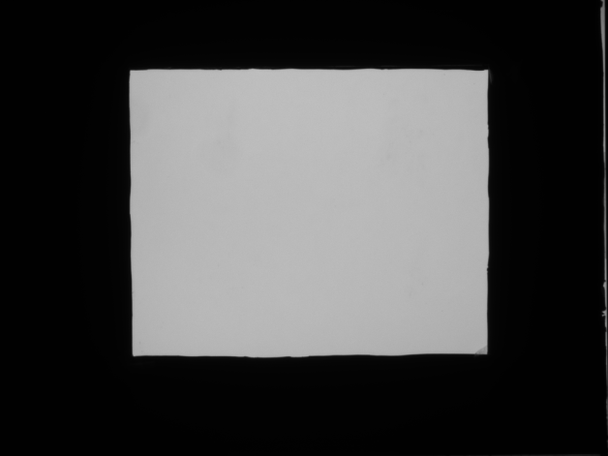
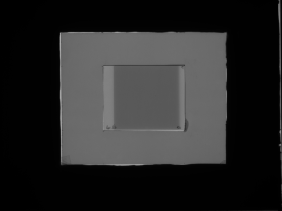
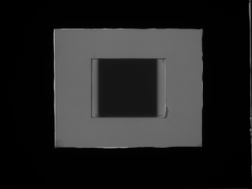
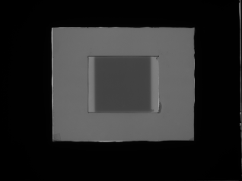
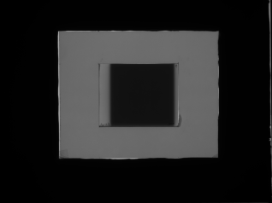
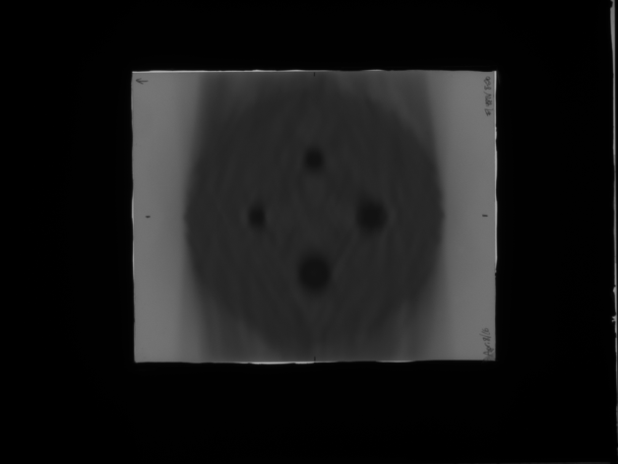
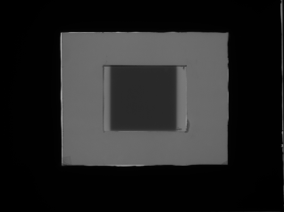

Where did this data come from?
Film imaged 24 hrs post-irr.
CCSEO Film Imager
Calibration Set
0 cGy
300 cGy
Empty Light Field
50 cGy
400 cGy
100 cGy
500 cGy
FSRT VMAT Delivery
200 cGy
600 cGy

Slide 14
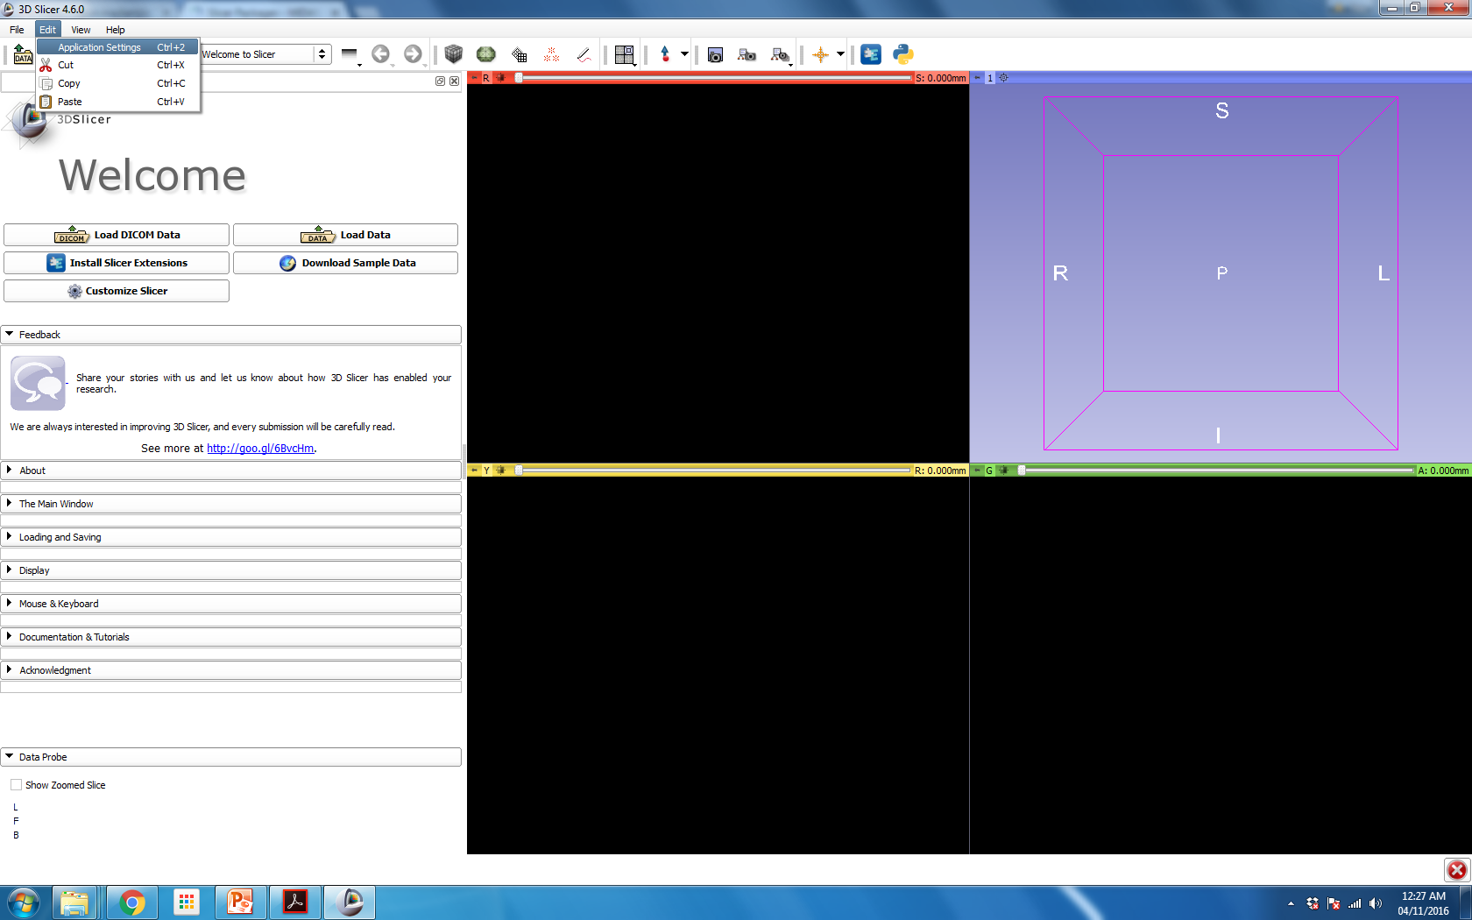
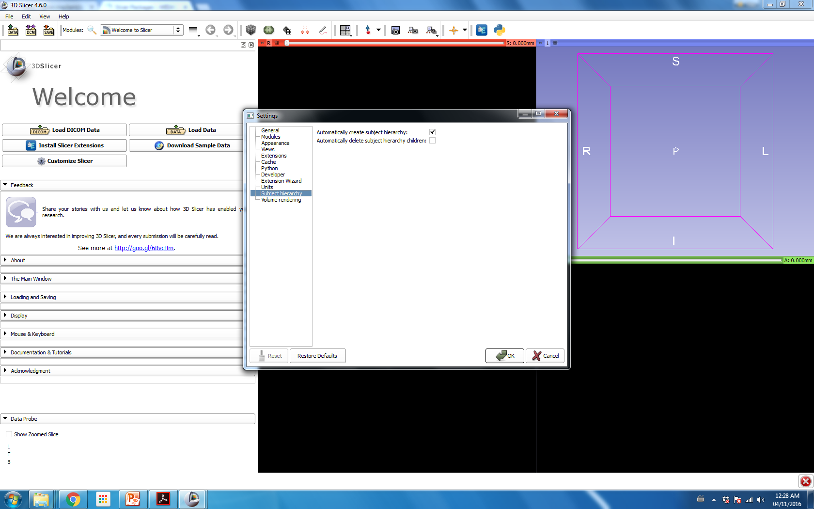
Before we begin…
Make sure ‘Automatically create subject hierarchy’ is checked!
Click OK and restart Slicer.

Slide 15
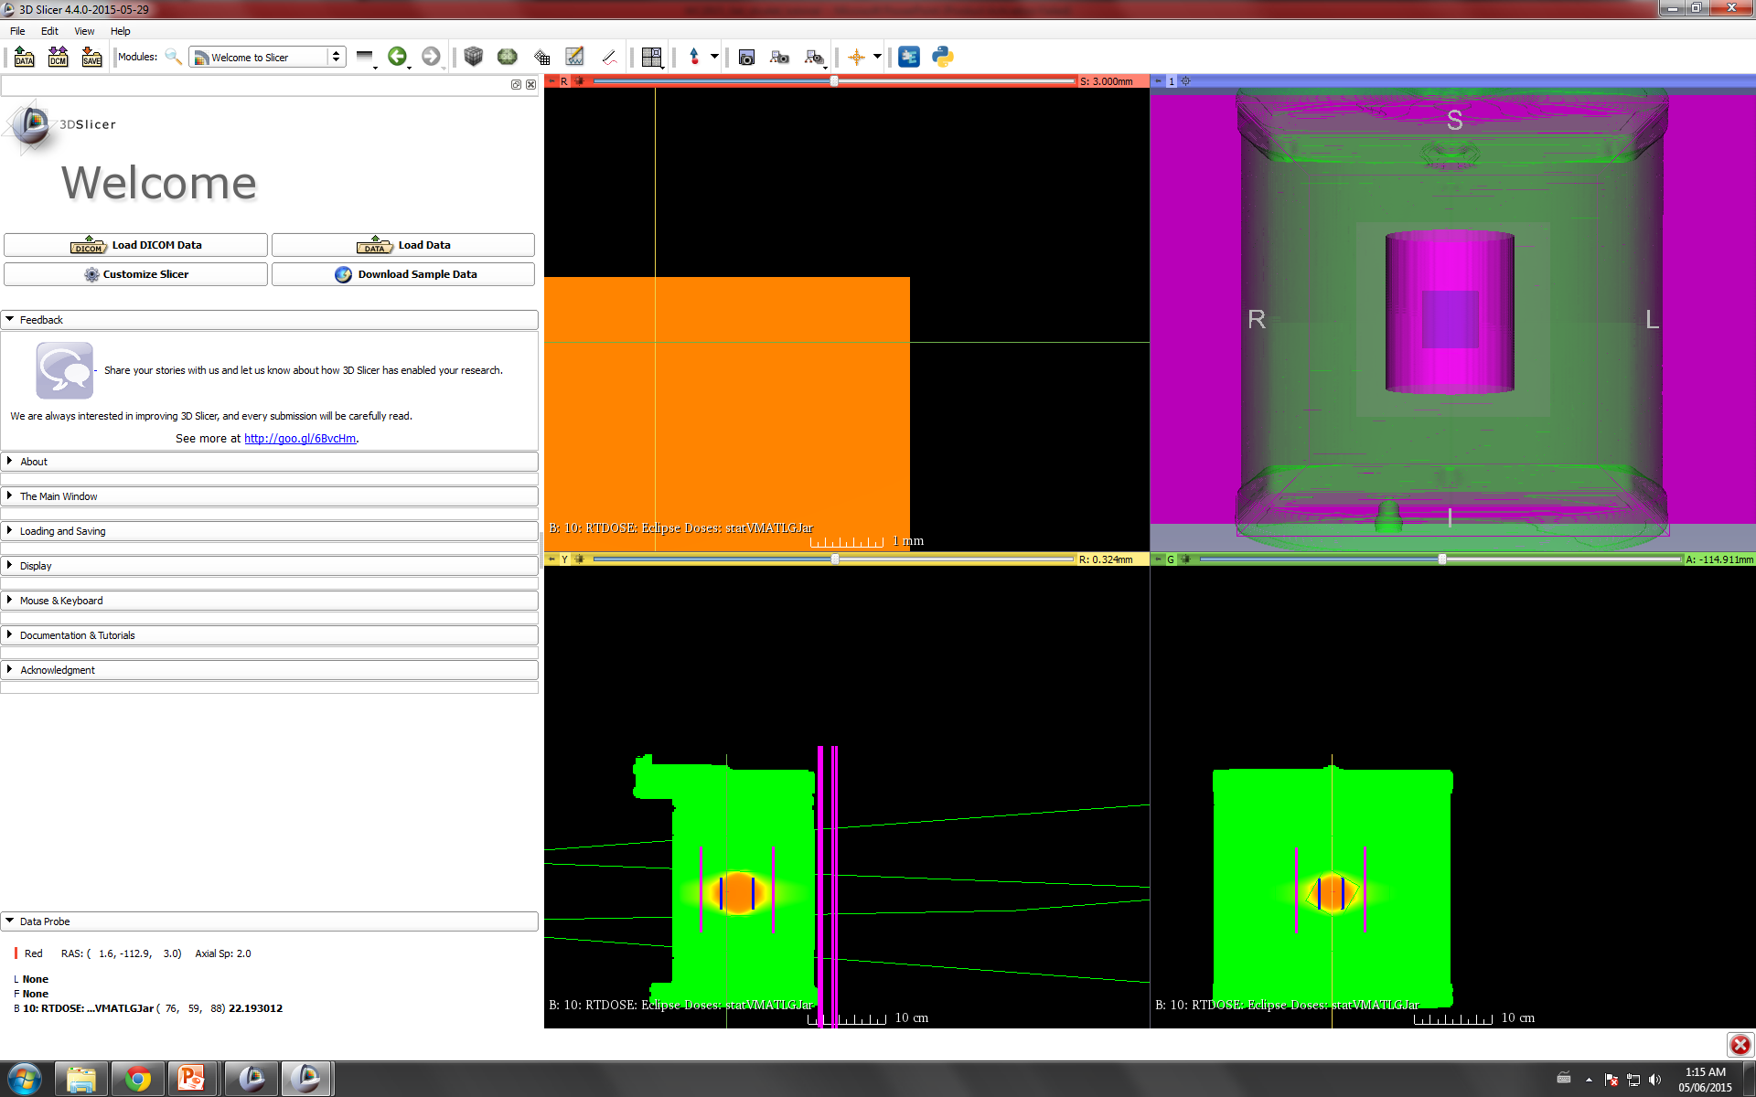
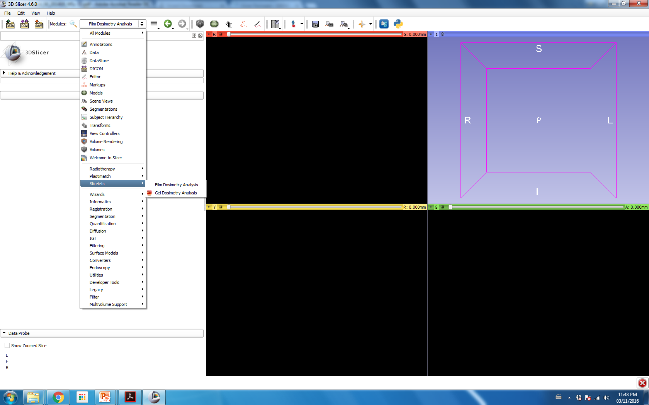
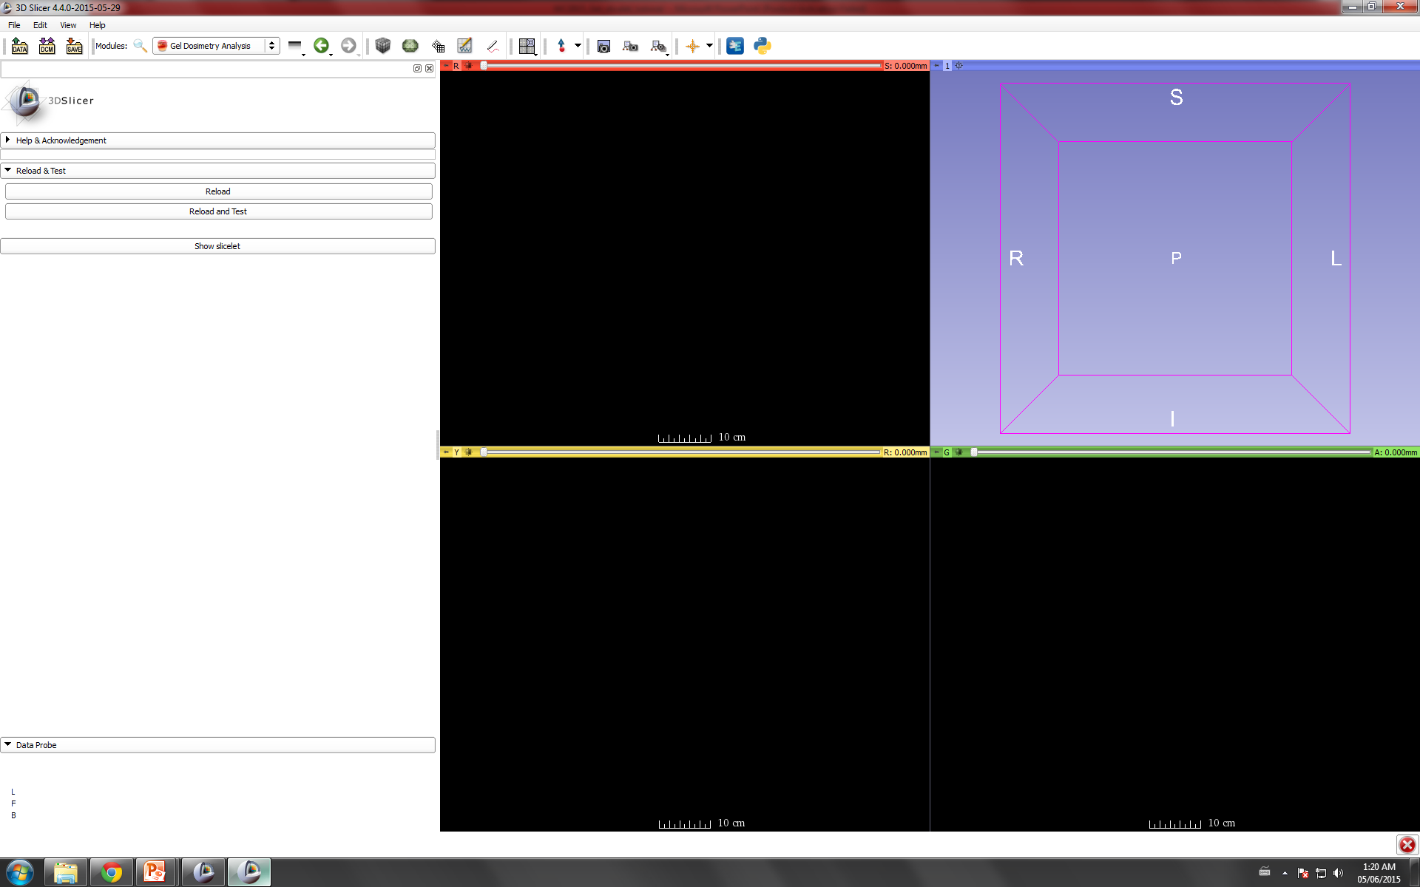
Open Film Dosimetry Analysis Slicelet

Slide 16
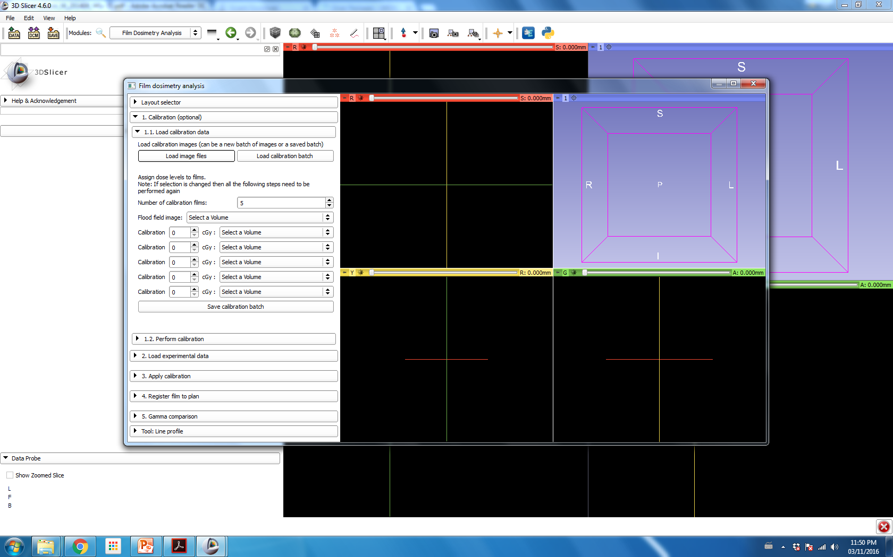
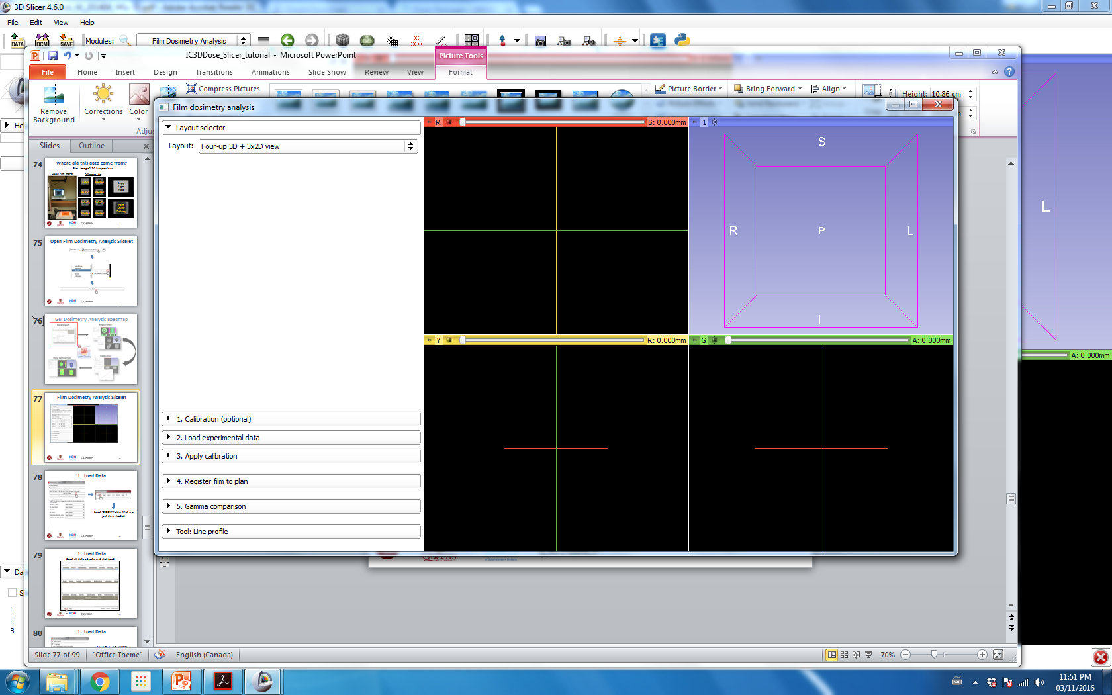
Film Dosimetry Analysis Slicelet

Slide 17
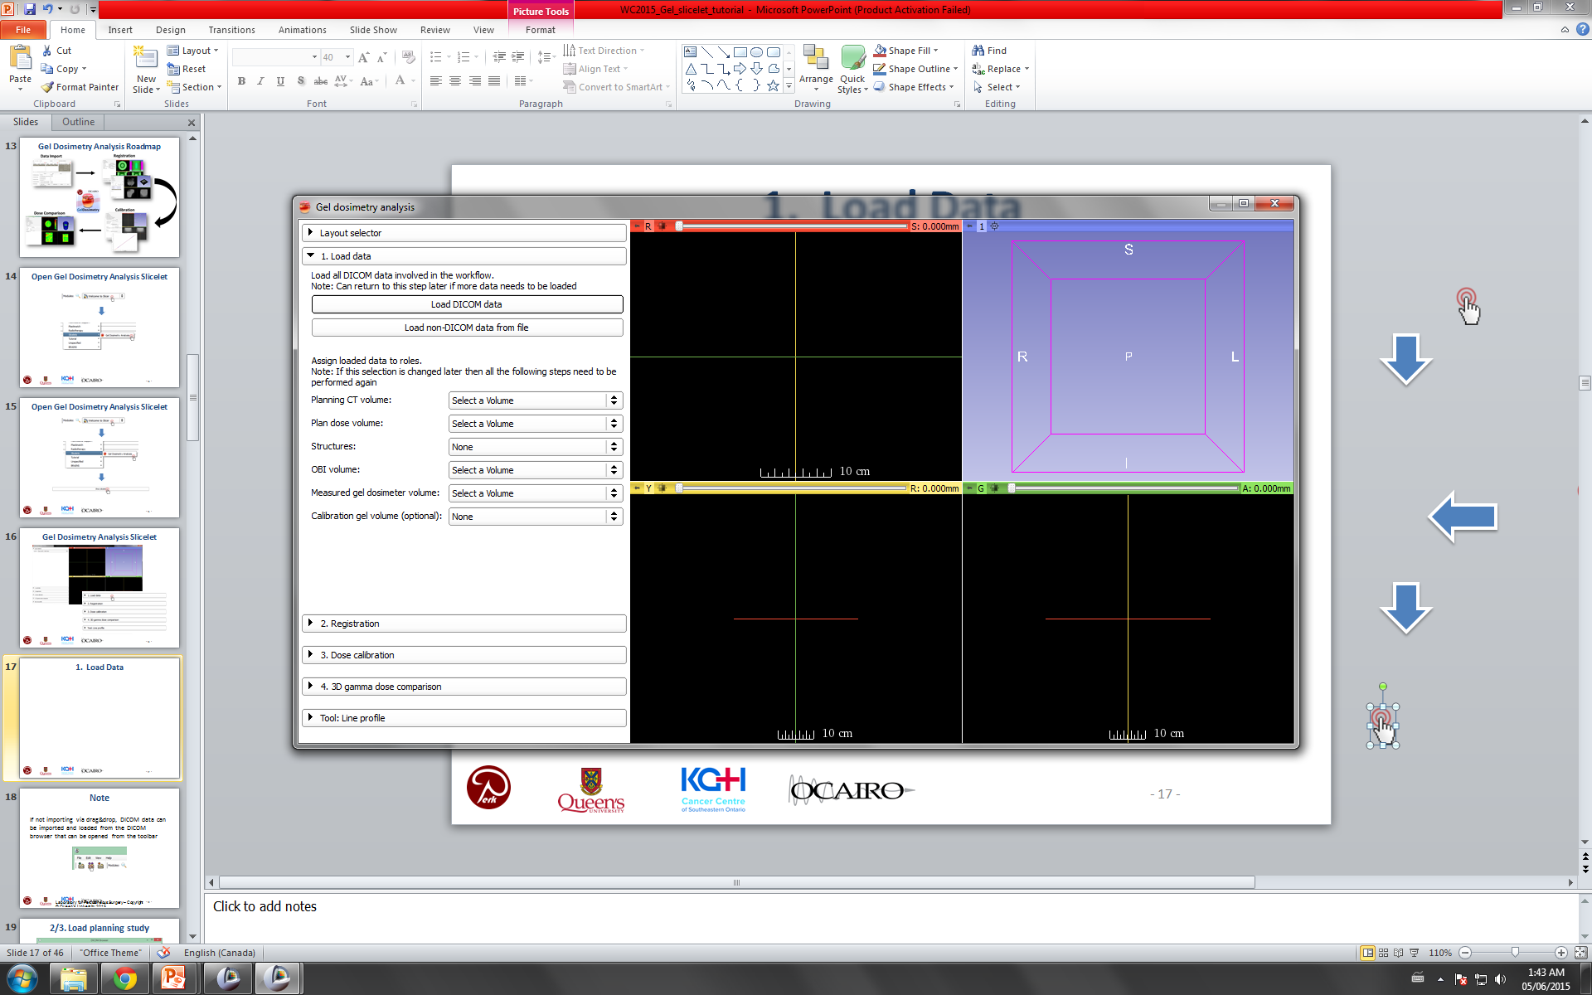
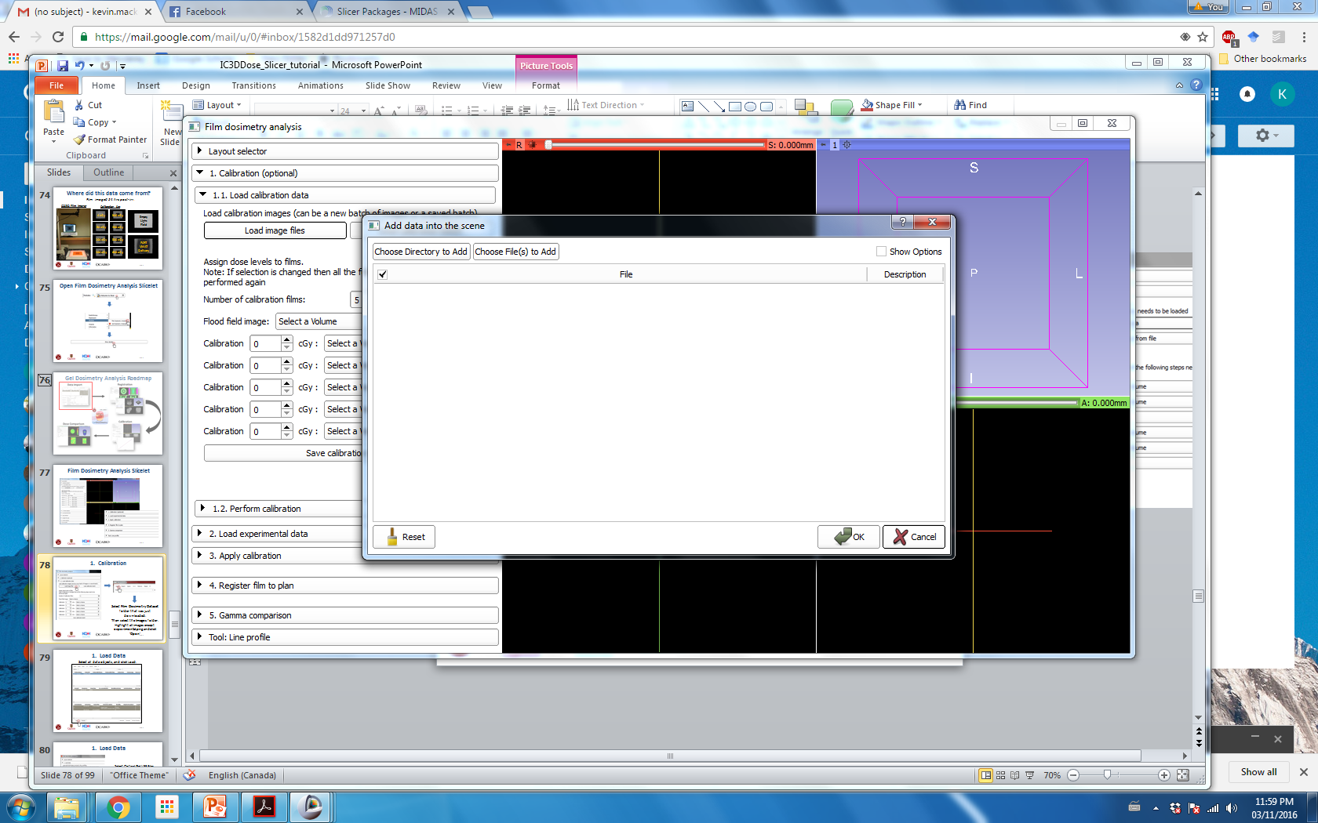
1. Calibration
Select Film Dosimetry Dataset folder that was just downloaded.
Then select the Images folder. Highlight all images except experimental.png and click ‘Open’

Slide 18
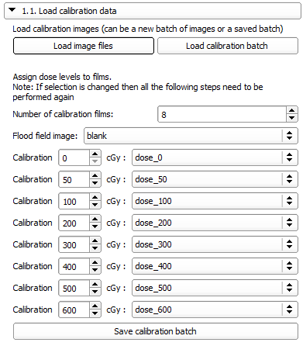
1. Calibration
Assign data and doses as shown

Slide 19
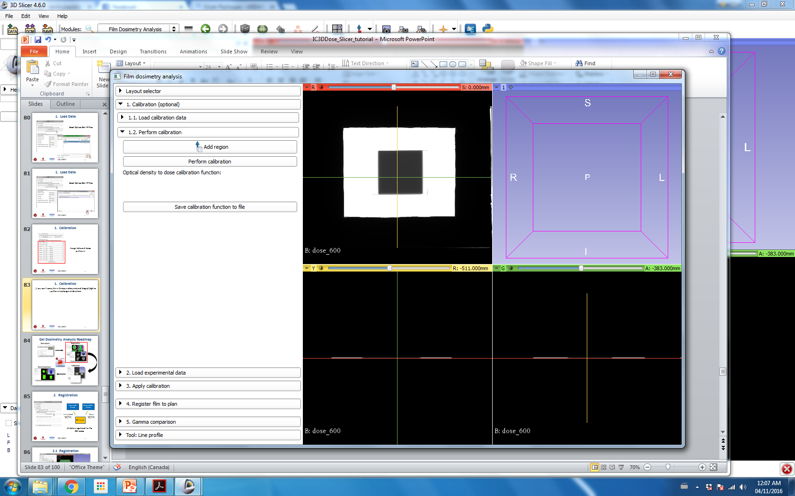
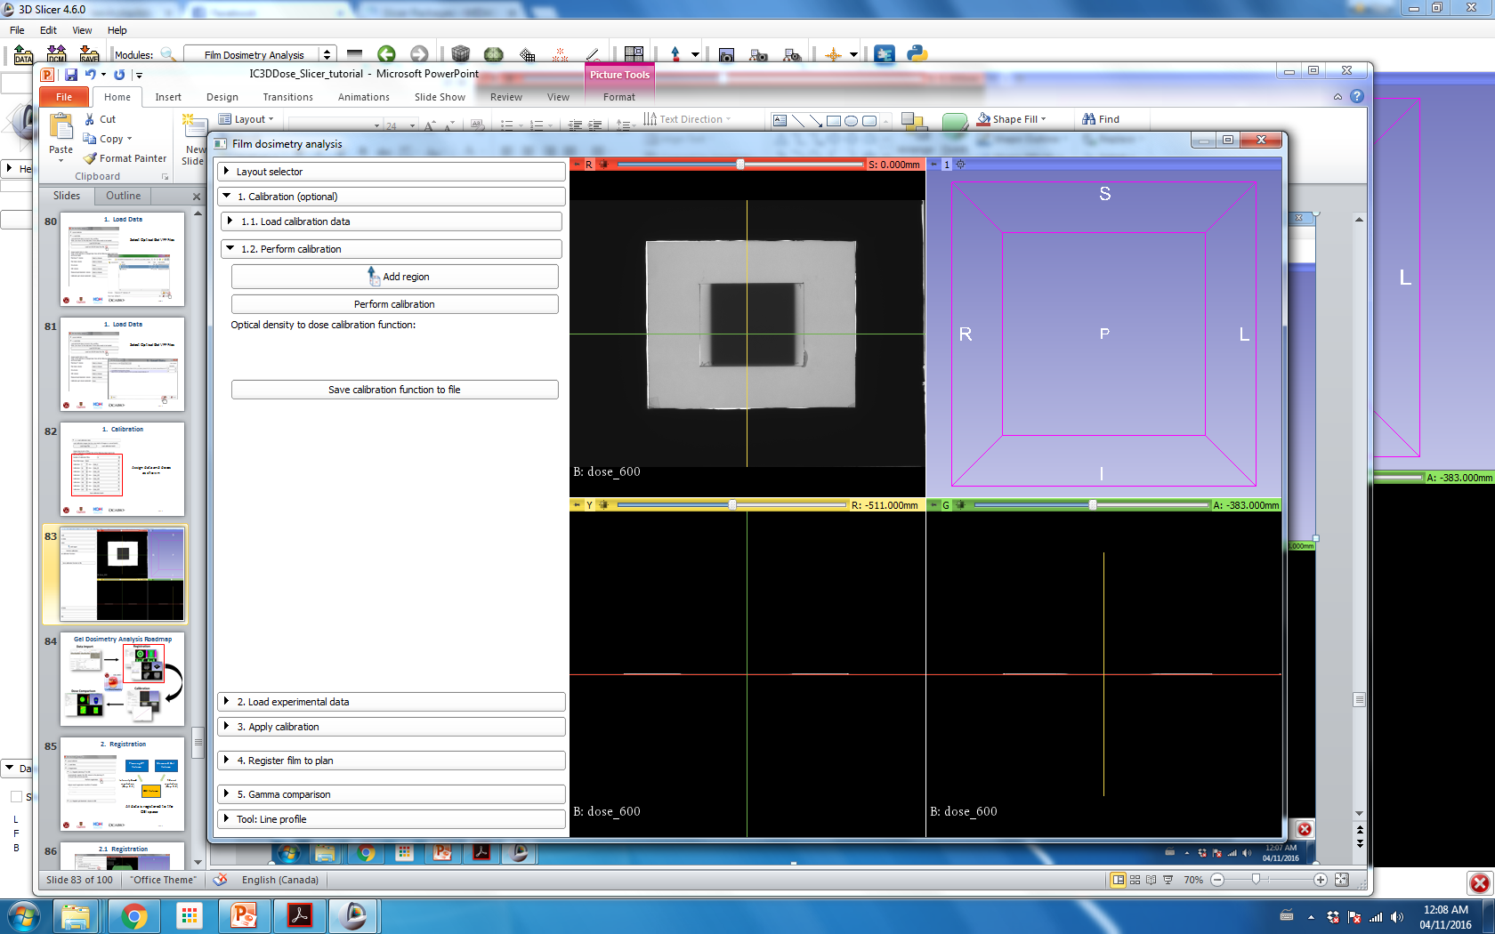
1. Calibration
If you can’t see a film in the top window, click and drag left/right or up/down to change window/level.
Click Add region, then click two times on the center of the film to define a region of interest (ROI).

Slide 20
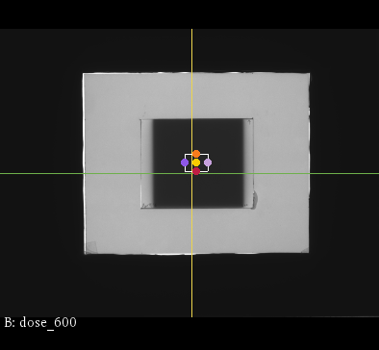
1. Calibration
Click and drag ROI towards center of irradiated field.

Slide 21
1. Calibration
Click Perform calibration.

Slide 22
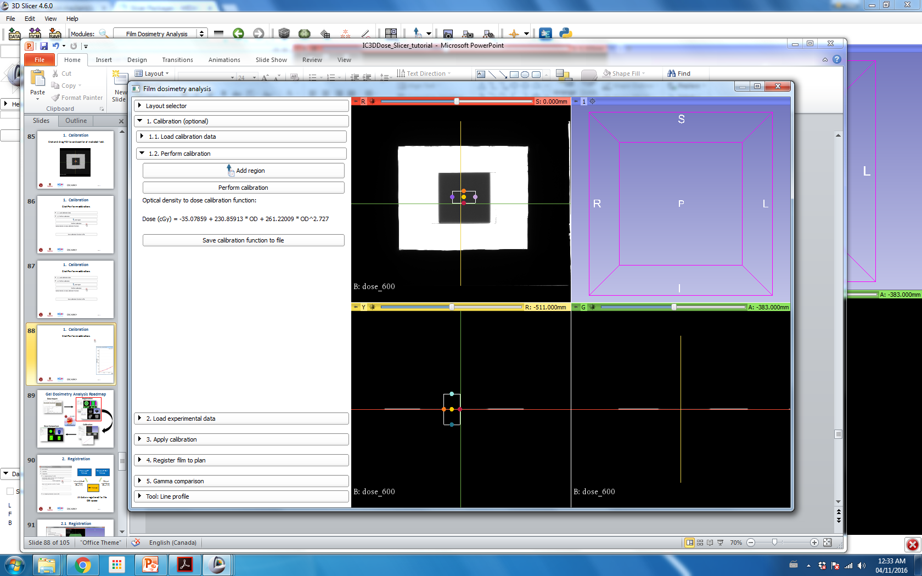
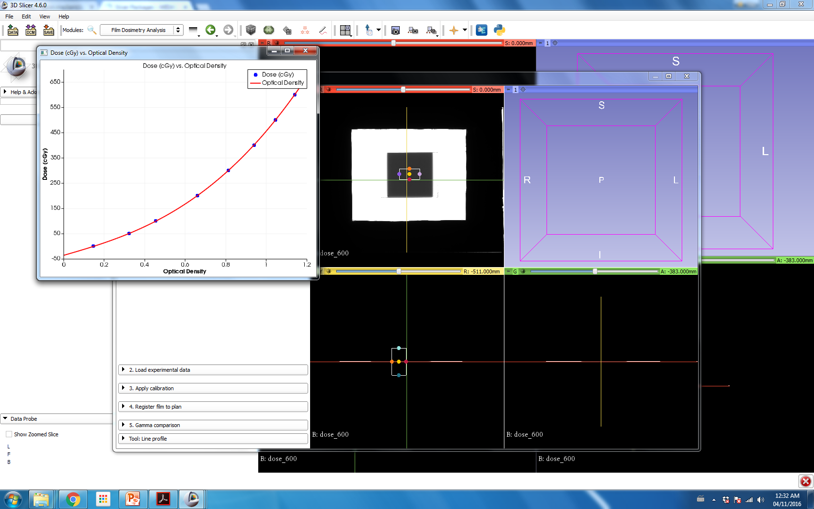
1. Calibration
Calibration function has been determined, of the form:
Dose = a + bOD + cOD^{n}

Slide 23
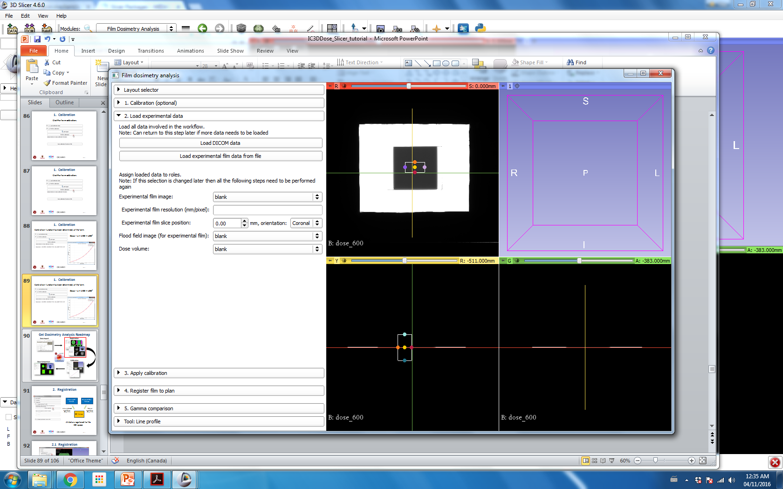
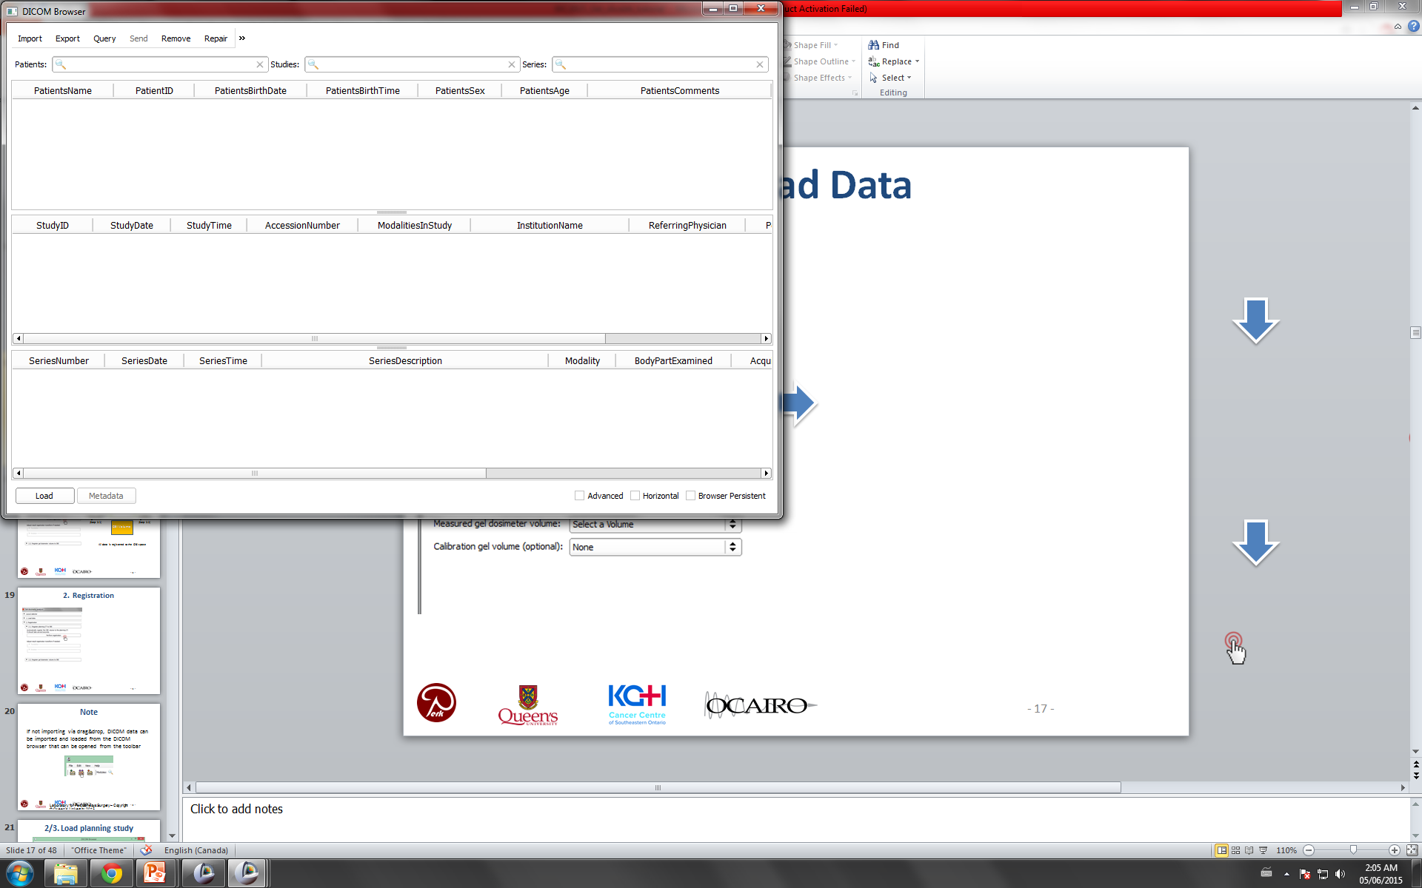
2. Load Experimental Data
Select Film Dosimetry Dataset folder.
Then select the DICOM folder. and click ‘Import’.
Then, when prompted click Add link.

Slide 24
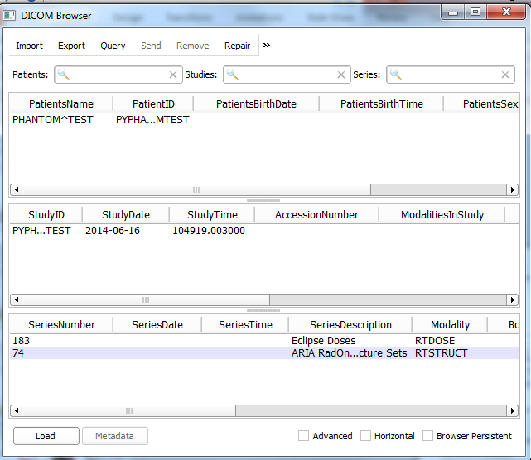
2. Load Experimental Data
Click the Phantom Test patient and click ‘Load’.

Slide 25
2. Load Experimental Data
Select Film Dosimetry Dataset folder that was just downloaded.
Then select the Images folder. Select the experimental.png file and click ‘Open’

Slide 26
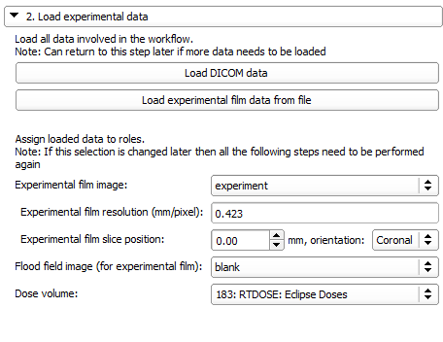
2. Load Experimental Data
Assign data as shown
Film resolution (mm/px) = 0.423
Define film plane and axis to be exported from DICOM dose distribution

Slide 27
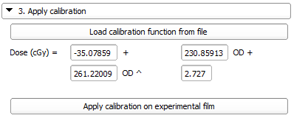
3. Apply calibration
Apply calibration to convert film from optical density to dose
Note: Calibration function can be imported from a previously saved file, or can be input manually in this step.

Slide 28

4. Registration
Click Perform registration to perform an intensity based registration between film and Eclipse dose plane

Slide 29
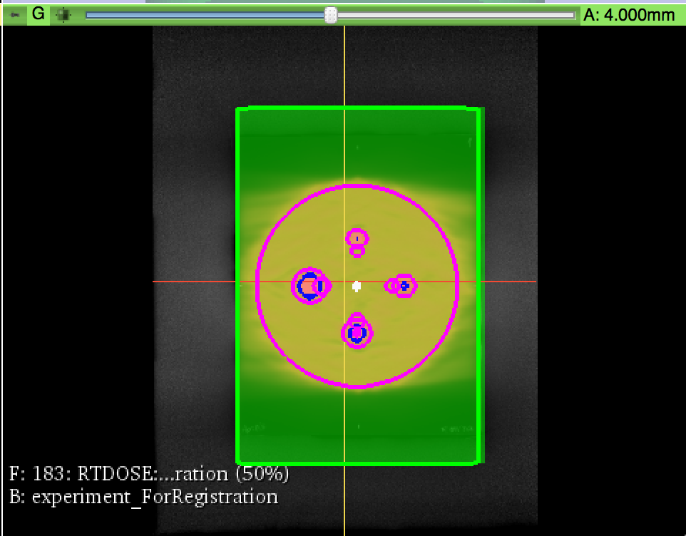
4. Registration
Click Perform registration to perform an intensity based registration between film and Eclipse dose plane
Grayscale: Calibrated film measurement
Greenscale: Eclipse dose plane
Registered!

Slide 30
5. Dose Comparison
Last step! Compare the measured film dose plane with the planned dose plane
We will use a 3D gamma comparison
Criteria: 3% dose difference, 3mm distance-to-agreement

Slide 31
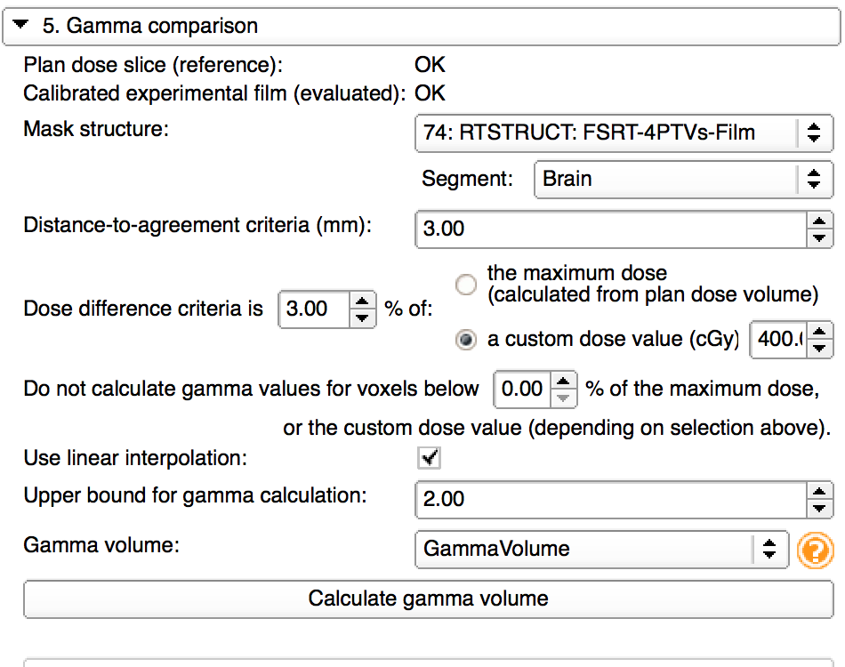
5. Dose Comparison
Dose maps are automatically assigned
Select 74: RTSTRUCT Structure set. Choose ‘Brain’ structure.
Set dose value to 400 cGy (prescription)
Set dose threshold to 0%
Create new gamma volume

Slide 32
5. Dose Comparison

Slide 33
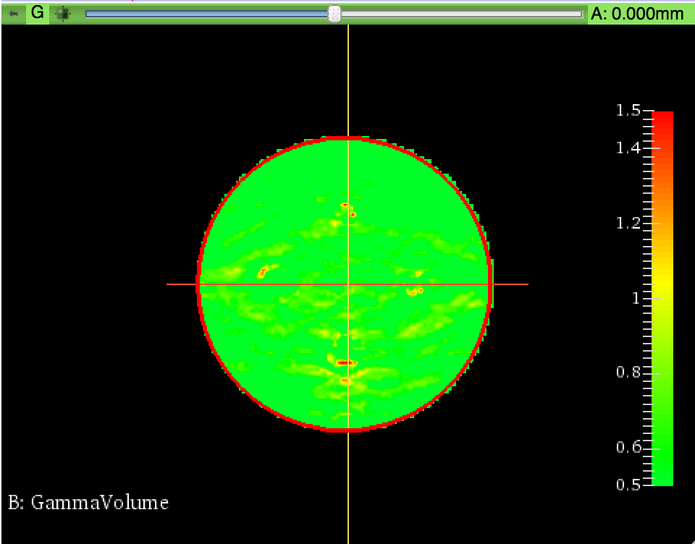
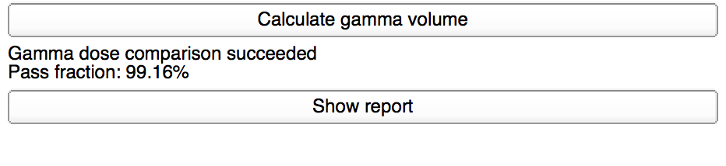
5. Dose Comparison

Slide 34
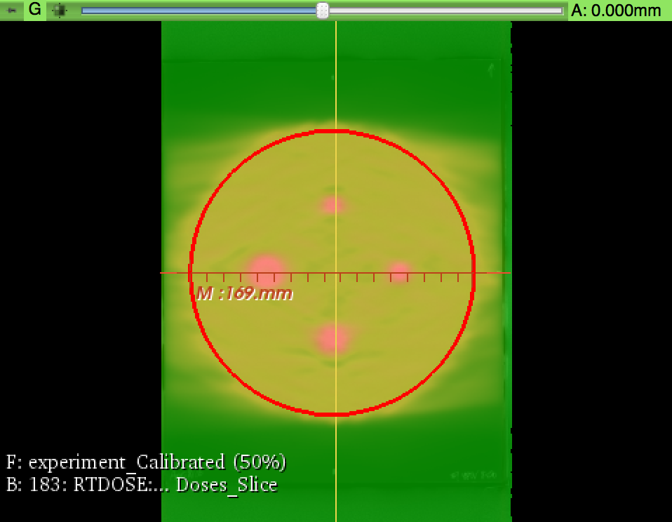
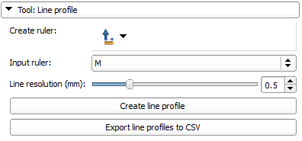
Line Profile
Draw line profile, with ruler tool.

Slide 35
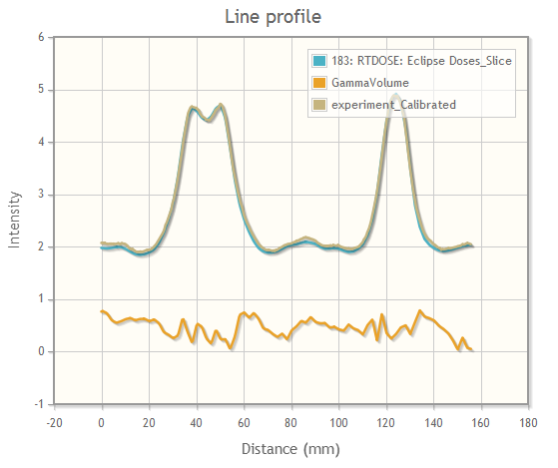
Line Profile
Click Create line profile to plot measured film dose, Eclipse dose, and gamma values

Slide 37

Tutorial: Gel Dosimetry Analysis Slicelet
IC3DDose 2016
November 10, 2016

Slide 38
Learning objective
This tutorial will teach you how to perform analysis of a gel dosimeter, imaged using an optical CT scanner.

Slide 39
Your concerns
“Largest obstacle to the use of Slicer RT and gel dosimetry in general is managing the complexity of the process and keeping track of and managing the large software feature set that is needed for the process to work well.”

Slide 40
Your concerns
“Concerned about validating results produced from these tools.”

Slide 41
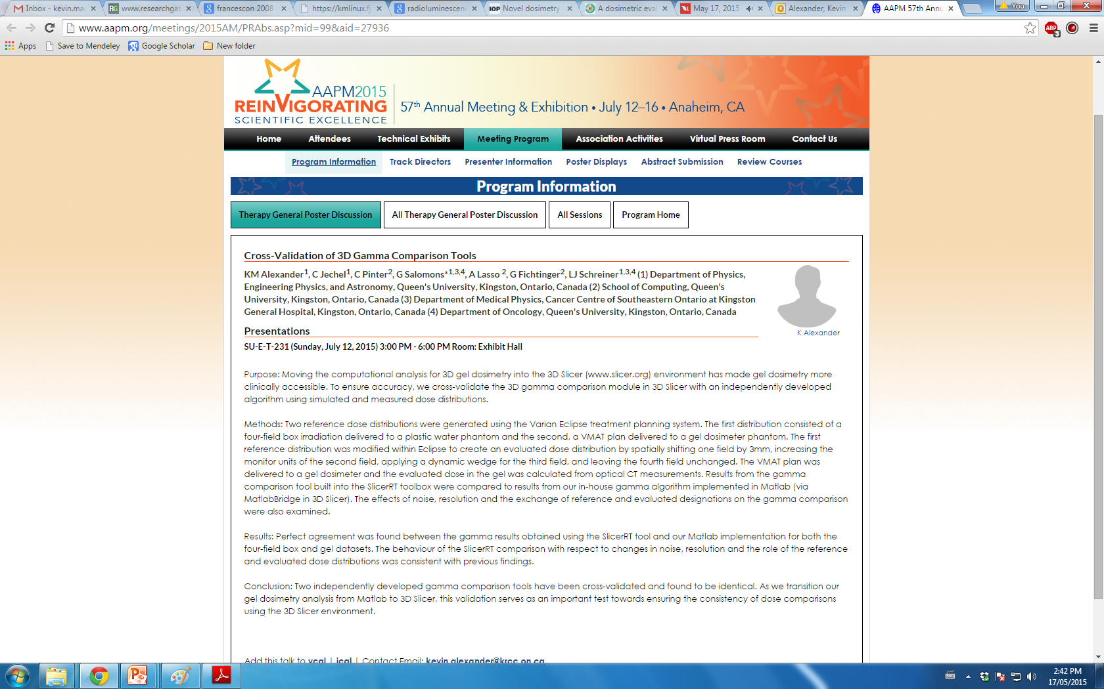
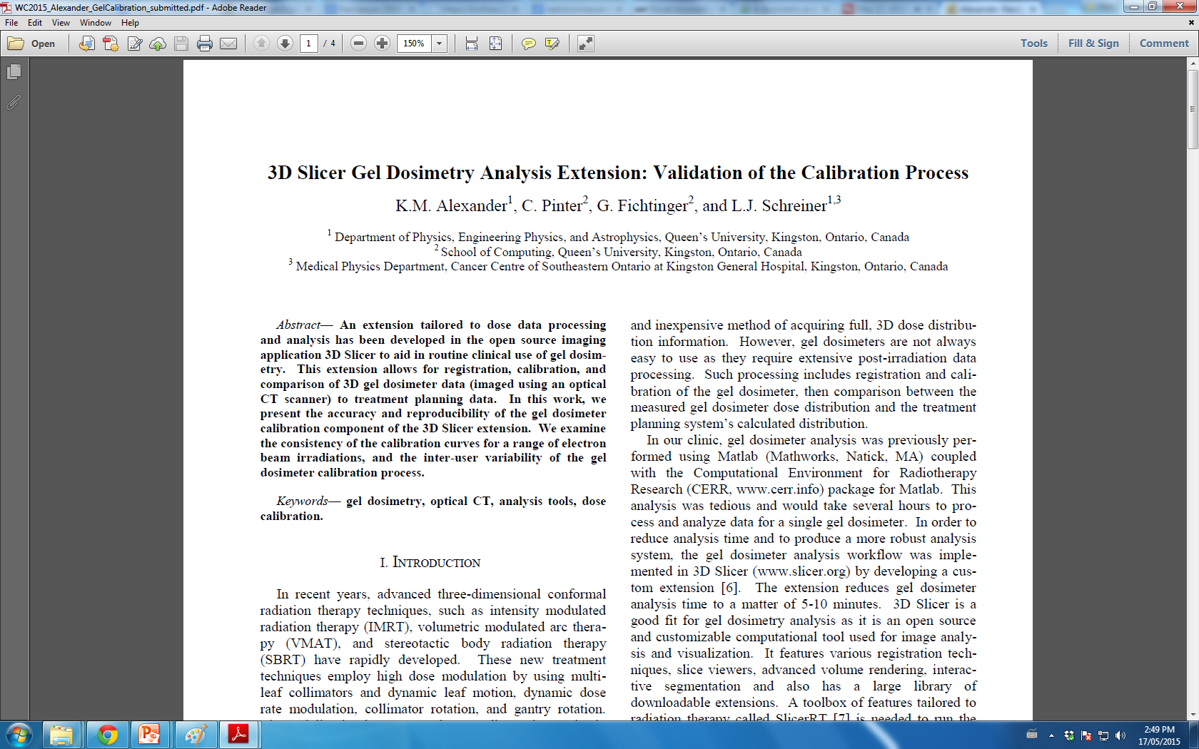
Your concerns about using 3D Slicer…
“Concerned about validating results produced from these tools.”

Slide 42
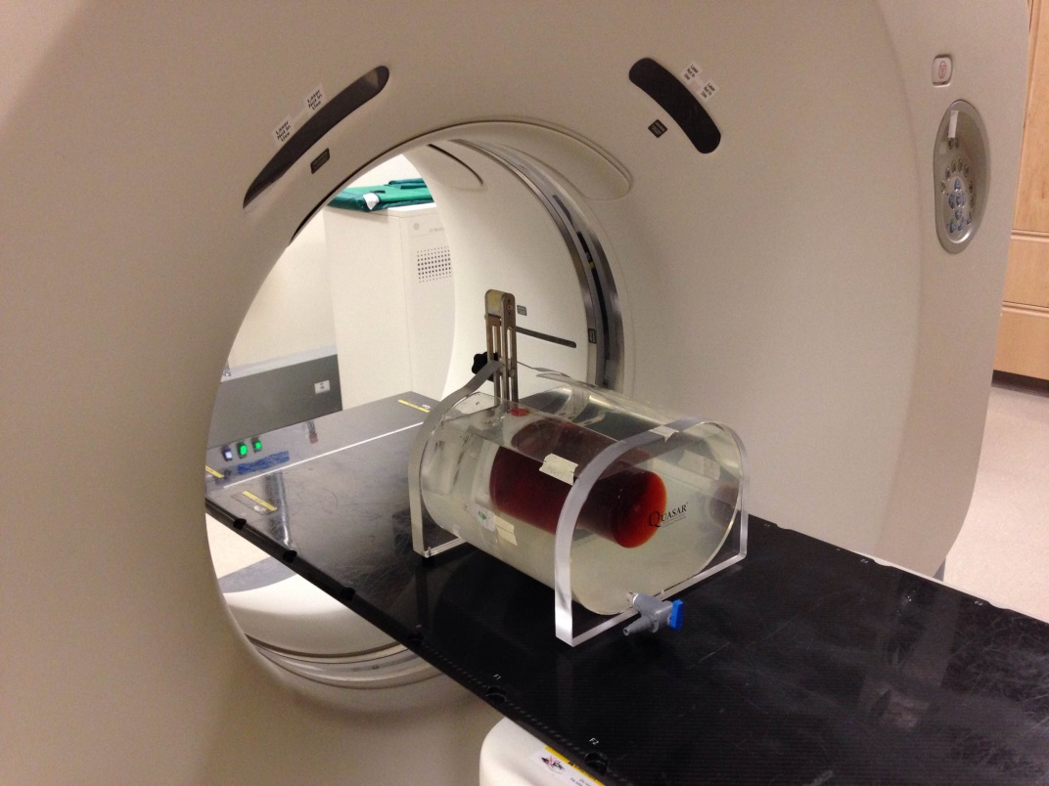
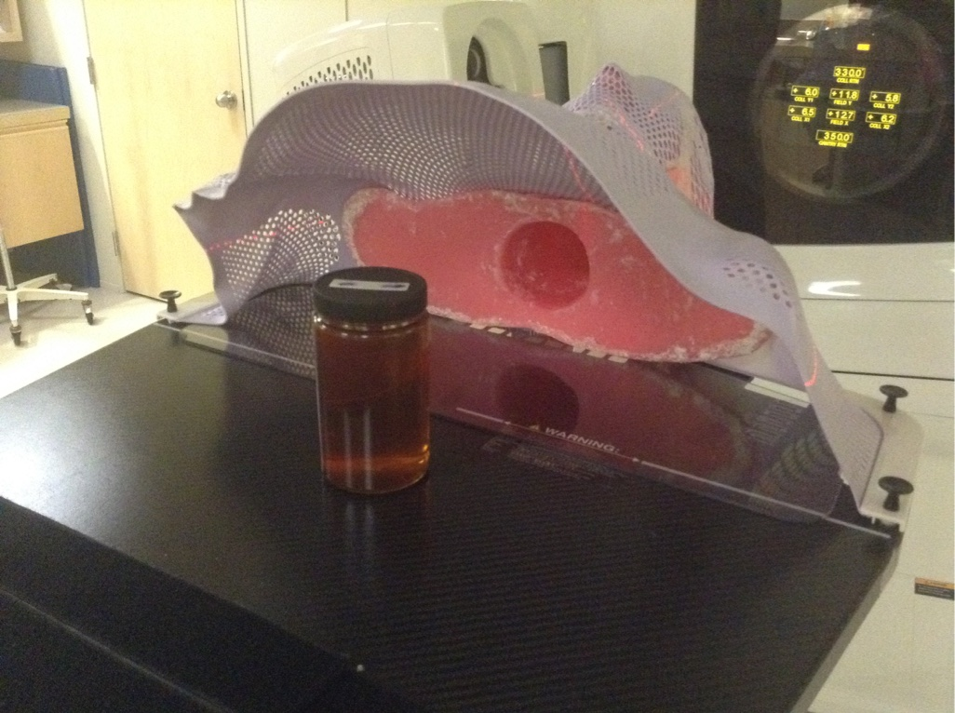
Where did this data come from?
Gel dosimeter was positioned inside a phantom, and CT simulation images were acquired (Planning CT volume)

Slide 43
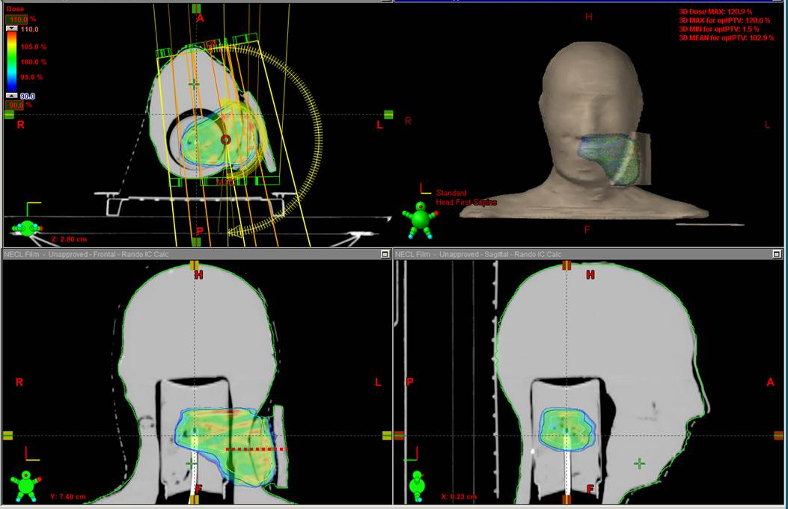
Where did this data come from?
Treatment planning using Eclipse:
Gel jar was contoured and dose distribution was calculated
Outputs: Planning dose volume, Structures

Slide 44
Where did this data come from?
Gel #1
Reference scan using an optical CT scanner
Optical fiducial markings are made with a marker, and metal BBs are taped to those markings
Gel #2
Reference scanned (no markings)
Phantom with gel is positioned on patient couch
Cone beam CT image is acquired using the On-Board Imager (OBI Volume)

Slide 45


Where did this data come from?
Gel #1 is irradiated with planned delivery
Gel #2 is irradiated with an electron beam
Gel #1 Gel #2

Slide 46
Where did this data come from?
Both gels are scanned post-irradiation, and are reconstructed to create 3D digital volumes (Measured gel dosimeter volume, calibration gel volume)

Slide 47


Gel Dosimetry Analysis Roadmap

Slide 48

Open Gel Dosimetry Analysis Slicelet

Slide 49
Gel Dosimetry Analysis Roadmap

Slide 50

Gel Dosimetry Analysis Slicelet

Slide 51
1. Load Data
Select ‘DICOM’ folder that was just downloaded

Slide 52

1. Load Data
Select all data objects, and click Load.

Slide 53

1. Load Data
Select Optical Gel VFF Files

Slide 54

1. Load Data
Select Optical Gel VFF Files

Slide 55

1. Load Data
Assign data as shown
Notes:
Update the screen grab

Slide 56
Gel Dosimetry Analysis Roadmap

Slide 57

2. Registration
Planning CT Volume
Measured Gel Volume
Intensity based registration (Step 2.1)
Fiducial registration (Step 2.2)
OBI Volume
All data is registered to the OBI space

Slide 58

2.1 Registration
Planning CT Volume: Grey OBI Volume: Green

Slide 59

2.1 Registration
If auto-registration fails or needs adjusting, manual adjustments can be performed
Use up/down arrows, or type in value

Slide 60

2.1 Registration
If auto-registration fails, or needs adjusting, manual adjustments can be performed
Use up/down arrows, or type in value
Notes:
For this case -1mm IS

Slide 61

2.2 Registration
OBI fiducial point selection

Slide 62
2.2 Registration
OBI fiducial point selection
Tip: Hold the shift key and explore the volume

Slide 63
2.2 Registration
#3
OBI fiducial point selection
#2
#1

Slide 64

2.2 Registration
#3
OBI fiducial point selection
#2
#1

Slide 65

2.2 Registration
OBI fiducial point selection

Slide 66

2.2 Registration
#3
Optical CT fiducial point selection
Optical CT fiducial point selection
#2
#1
Tip: Adjust the window/level by clicking, holding, and dragging up/down and left/right

Slide 67


2.2 Registration

Slide 68
“How accurate is fiducial registration?”

Slide 69
“How accurate is fiducial registration?”
Root-mean square error between the two sets of fiducial points

Slide 70
Gel Dosimetry Analysis Roadmap

Slide 71
3. Calibration
Determine how optical density in the gel relates to dose
Here, we use a percent depth-dose (PDD) method about the central axis of the gel jar
We will align:
Gel optical density measurements
Water tank ion chamber PDD data

Slide 72

3.1 Calibration
Gel #2

Slide 73

3.1 Calibration
Select 12MeV_3x3.csv file, and click ‘Open’

Slide 74

3.1 Calibration
For this delivery:
Relative dose factor (RDF) = 0.929
(3x3 cm², 12 MeV electron beam)
Delivered monitor units (MUs) = 250
Averaging radius (mm) = 3

Slide 75

3.1 Calibration

Slide 76


3.1 Calibration
Automated PDD alignment
Adjust alignment using:
Blue: Commissioning PDD data Green: Shifted and scaled optical density data

Slide 77

3.1 Calibration
Automated PDD alignment
Adjust alignment using:
-0.68
498.00
-11.3
Blue: Commissioning PDD data Green: Shifted and scaled optical density data

Slide 78

3.1 Calibration

Slide 79
3.1 Calibration

Slide 80


3.1 Calibration
Right click and draw box around region to use for calibration

Slide 81



3.2 Calibration
Calibration function is determined and applied to measured gel volume

Slide 82
Gel Dosimetry Analysis Roadmap

Slide 83
4. Dose Comparison
Last step! Compare the measured gel dose volume with the planned dose volume (using the treatment planning system)
We will use a 3D gamma comparison
Criteria: 3% dose difference, 3mm distance-to-agreement

Slide 84

4. Dose Comparison
Volumes are automatically assigned
Select ‘Rando Gel’ structure set Choose the ‘PTV Eval’ structure

Slide 85
4. Dose Comparison
Note: Two ways to specify dose difference

Slide 86
4. Dose Comparison
Dose threshold: Where to calculate gamma

Slide 87
4. Dose Comparison
Create new gamma volume

Slide 88
4. Dose Comparison

Slide 89

4. Dose Comparison

Slide 90
4. Dose Comparison

Slide 91

Line Profile
Click ruler tool, and click at start and end of desired line.
Draw line profile, with ruler tool, then click ‘Create line profile’ to view.

Slide 92
From our online survey
“Concerning Gel Dosimetry slicelet:
Is it possible to save the result of an analysis? What if I don't want to go over the procedure every time for the same piece of data?”

Slide 93


Slide 94


Slide 95
Wrap-up
Thanks for participating!
Let us know if you have any questions or suggestions
kevin.alexander@krcc.on.ca

